Slide 1
Advanced Java Programming
Object Relational Mapping

Slide 2
Contents
What is Object Relational Mapping
How ORM Works
Features of ORM
Advantages
Java ORM- Hibernate, JAVA Persistence API(JPA)

Slide 3
ORM
ORM is a programming technique that allows you to interact with a database using object-oriented programming (OOP) concepts, rather than writing raw SQL queries.
Database is a collection of tables with rows and columns, and each row representing a record of data.
On the other hand, in object-oriented programming, works with classes and objects, where each object has attributes (similar to columns in a table) and methods (functions associated with the object).

Slide 4
ORM
ORM acts as a bridge between these two worlds.
It maps the data in the database tables to objects in your code and vice versa.
This means you can interact with the database using familiar OOP methods like creating, reading, updating, and deleting records, without needing to write complex SQL queries explicitly.

Slide 5
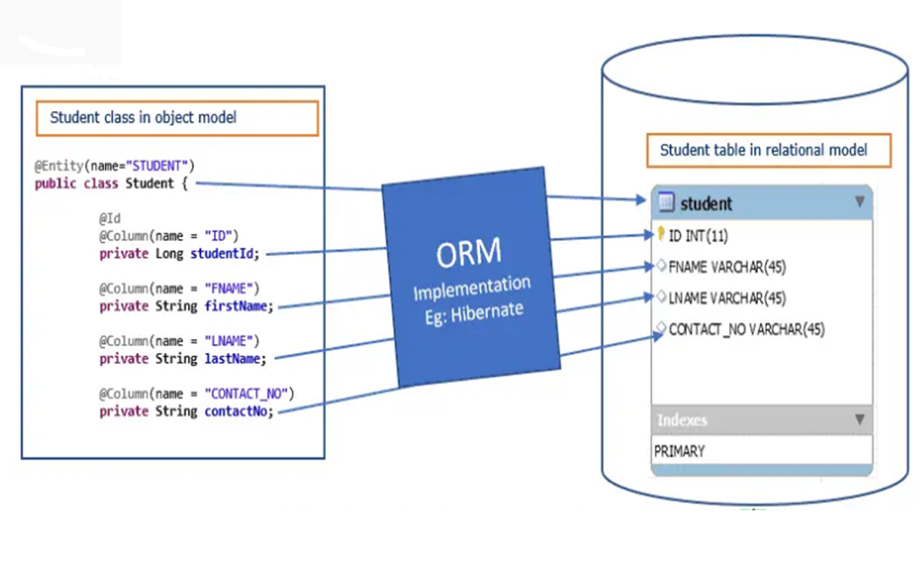
ORM

Slide 6
ORM
Here's an example of SQL code that retrieves information about a particular user from a database:
"SELECT id, name, email, country, phone_number FROM users WHERE id = 20"
On the other hand, an ORM tool can do the same query as above with simpler methods. That is:
users.GetById(20)
Using an ORM simplifies database interactions, makes your code more maintainable, and often reduces the amount of boilerplate code you need to write, as the ORM handles many aspects of the database operations for you.

Slide 7
Why ORM?
If you choose not to use ORM (Object-Relational Mapping), you will have to interact with the database using raw SQL queries directly in your code. Here are some consequences of not using ORM:
Database Independence: Writing raw SQL queries ties your code directly to the specific database technology you are using.
If you ever decide to switch to a different database system, you'll need to rewrite significant portions of your data access layer.

Slide 8
Why ORM?
You can switch between different database management systems (e.g., MySQL, PostgreSQL, SQLite) without having to rewrite the application code.
It offers flexibility and allows developers to work with various databases seamlessly.

Slide 9
Why ORM?
Abstraction: ORM provides a level of abstraction, making it easier to work with databases using object-oriented concepts.
Without ORM, you'll need to handle low-level database details, potentially making your code less readable and more tightly coupled to the database schema.

Slide 10
Why ORM?
Simplicity and Productivity: Writing raw SQL queries can be more challenging and error-prone, especially for developers who are not familiar with SQL or database intricacies.
It requires understanding the database schema, table structures, and proper syntax for different database management systems.
This allows developers to focus on the application's business logic rather than dealing with low-level database operations. As a result, it increases productivity and reduces development time.

Slide 11
Why ORM?
Maintainability and Code Reusability: Without ORM, you'll need to write more code to handle database interactions, including query building, parameter binding, and result parsing.
This leads to more lines of code, which can be harder to maintain and debug in the long run.
ORM promotes a more organized and maintainable codebase. Developers can define reusable data models and access patterns, leading to cleaner, easier-to-maintain code.

Slide 12
Why ORM?
Performance and Optimization: While ORM can introduce a slight performance overhead, ORM libraries are often optimized to generate efficient SQL queries and handle common performance issues.
Writing optimized raw SQL queries yourself may require more effort and knowledge of database optimizations.

Slide 13
Why ORM?
Testing: When using raw SQL queries, testing database interactions can become more complicated.
You'll need to set up test databases or implement mocks for your queries to simulate database behavior during testing.

Slide 14
Impedance Mismatch
The Object Oriented (Domain) model use classes whereas the relational database use tables.
This creates a gap (The Impedance Mismatch).
Due to the difference between the two different models, getting the data and associations from objects into relational table structure and vice versa requires a lot of tedious programming.

Slide 15
Impedance Mismatch
Loading and storing objects using a tabular relational database exposes us to 5 mismatch problems.
Granularity
Inheritance
Identity
Associations
Performance Overhead

Slide 16
Impedance Mismatch
Granularity
Granularity is the extent to which a system could be broken down into small parts.
Lets take an example of Person details, we could break down person details into two classes one is Person and another is Address for code re-usability and code maintainability purpose.
But assume that to store Person details in database there is only one table called Person.

Slide 17
Impedance Mismatch
Granularity
Sometimes you will have an object model which has more classes than the number of corresponding tables in the database (we says the object model is more granular than the relational model).
This is Granularity Mismatch between Object Model and Relational Model.

Slide 18
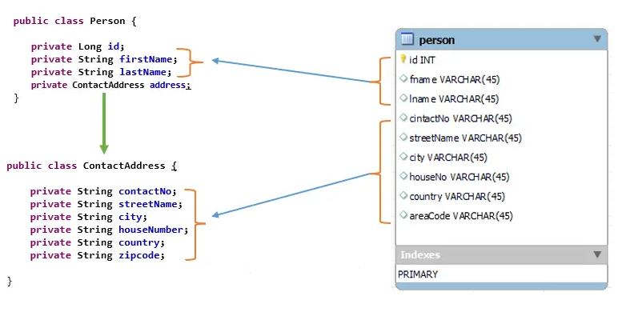
Impedance Mismatch
Granularity

Slide 19
Impedance Mismatch
Inheritance or Sub-types
Inheritance is a natural concept in object-oriented programming languages.
However, RDBMSs do not define anything similar on the whole (yes some databases do have subtype support but it is completely non-standardized).
This is Inheritance Mismatch between Object Model and Relational Model.

Slide 20
Impedance Mismatch
Identity
A RDBMS defines exactly one notion of ‘sameness’: the primary key.
In the Relational Model, two different rows in a table are only considered the same if they have the same primary key value, regardless of the other attributes they might have.
Java, however, defines both object identity a==b and object equality a.equals(b).
The difference in notions of "sameness" between the two models creates the Identity Mismatch.

Slide 21
Impedance Mismatch
Associations
Associations are represented as unidirectional references in Object Oriented languages whereas RDBMSs associations are bidirectional by using foreign keys.
If you need bidirectional relationships in Java, you must define the association twice.
Likewise, you cannot determine the multiplicity of a relationship by looking at the object domain model.

Slide 22
Impedance Mismatch
Performance Overhead
The process of converting objects to relational data and vice versa can introduce performance overhead, especially when working with large datasets or complex object hierarchies.

Slide 23
Impedance Mismatch
ORM attempts to address the impedance mismatch by providing a layer of abstraction that handles the translation between the object-oriented model and the relational model.
It simplifies data access by allowing developers to work with objects directly, while behind the scenes, the ORM library handles the interactions with the relational database.
While ORM can significantly reduce the impedance mismatch and make database interactions more manageable, it's essential for developers to have a good understanding of both the object-oriented and relational models to design efficient and effective data models for their applications.

Slide 24
How ORM Works
Mapping Data Models:
In ORM, you define classes and objects that represent the entities in your application domain. These classes are often referred to as "data models" or "entity classes."
Each data model class typically corresponds to a table in the relational database, and the class attributes represent the table columns.

Slide 25
How ORM Works
Configuration
Before using ORM, you need to configure the mapping between the data models and the corresponding database tables. This configuration helps ORM understand how to translate object-oriented concepts to relational database operations.
Configuration may involve specifying the primary keys, relationships between different data models (e.g., one-to-one, one-to-many, many-to-many), and other database-specific settings.

Slide 26
How ORM Works
CRUD Operations:
ORM provides methods or functions to perform CRUD (Create, Read, Update, Delete) operations on the data models.
Create: To insert new records into the database, you create new objects of the data model classes and save them using ORM methods.
Read: To fetch data from the database, you use ORM methods to execute queries, and the results are returned as objects of the corresponding data models.
Update: To modify existing records, you retrieve the object from the database, update its attributes, and then save the changes back to the database using ORM methods.
Delete: To remove records, you use ORM methods to delete objects, and ORM takes care of deleting the corresponding rows from the database.

Slide 27
How ORM Works
Querying:
ORM provides an API for writing and executing database queries using object-oriented syntax.
Instead of writing raw SQL queries, you can use methods provided by the ORM library to construct queries based on the data model classes and their attributes.

Slide 28
How ORM Works
Transactions and Data Integrity:
ORM helps manage database transactions, ensuring that multiple operations are executed as a single unit of work, maintaining data integrity and consistency.
ORM can handle data validation and enforce constraints, such as unique values and foreign key references, to ensure data integrity.

Slide 29
Java ORM
Java offers several popular ORM (Object-Relational Mapping) frameworks that simplify database interactions in Java applications. Some of the well-known Java ORM frameworks are:
Hibernate
Java Persistence API (JPA)
EclipseLink
Spring Data JPA
Apache OpenJPA
MyBatis

Slide 30
ORM
Popular ORM Frameworks in other programming Languages
Python – Django, SQLAlchemy
GoLang – GORM
NodeJS – TypeORM, Sequelize, KnexJS
PHP – Propel, Doctrine
C# and .Net – Entity Framework, NHibernate

